Slide 1
Robust principal axes determination for point-based shapes
Quim Sanchez
Gerard Bahi

Slide 2
Contents
Libraries
Algorithm
Class design
Results
Conclusions
Future work
Demostration

Slide 3




Libraries
STL
Linear Algebra
Mesh handeling

Slide 4
Algorithm
Clean Subset selection
RANSAC
Subset selection
Pure random selection
Octree powered random selection
LMS evaluation
Forward Search
Move points to major region

Slide 5
Finding axis
First axis
Apply algorithm on the points
Second axis
Apply algorithm on the projected points
Third axis
Cross product of the two firs axis

Slide 6
Class design
QGLViewerWidget
LinalgTools
Axis3D
MeshViewerWidget<T>
Mesh
MeshTranslator
PrincipalAxisGenerator
MeshViewerWidget
MainWindow

Slide 7
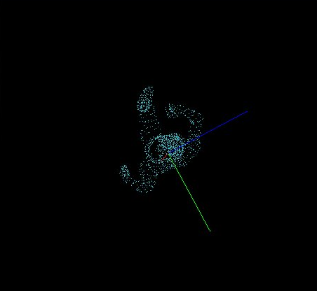
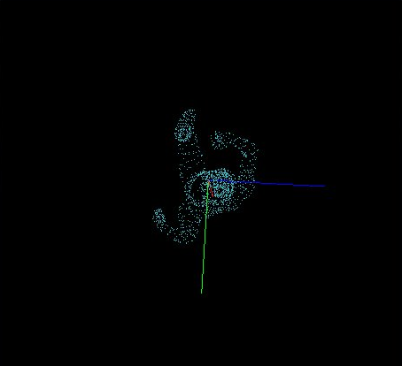
Results
PCA
RPCA

Slide 8
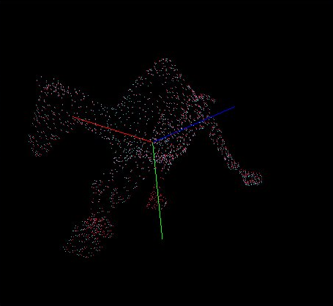
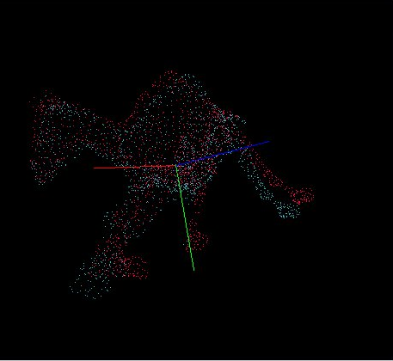
Results
PCA
RPCA

Slide 9
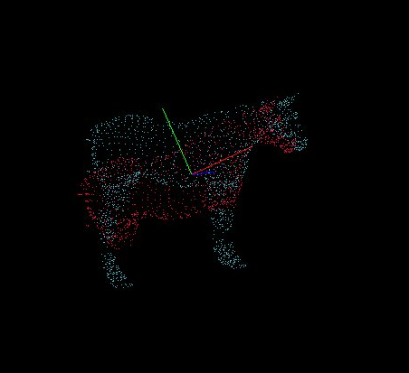
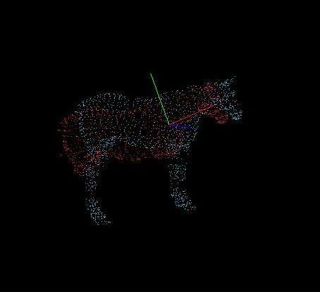
Results
PCA
RPCA

Slide 10
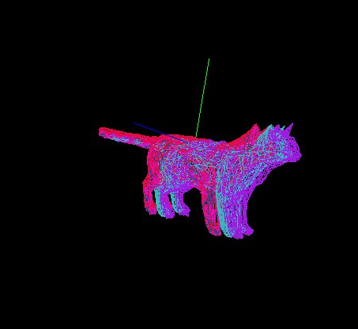
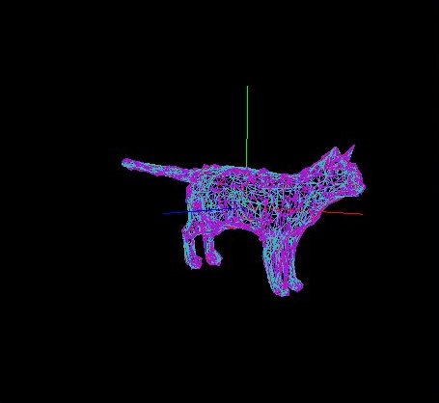
Results
PCA
RPCA

Slide 11
Conclusions
Agile software development methodology was a good approach
Results obtained between the axis computing methods seem to be logical
Good method to get first axis but not the second one

Slide 12
Future work
Octree implementation
Axes direction correction
Implement PrincipalAxisGenerator using the Command design pattern
Improve GUI fetaures

Slide 13
Demonstration

